Slide 1
Practical 2
PT5053
Lucy Metcalfe
Senior Lecturer Physiotherapy
l.metcalfe1@londonmet.ac.uk

Slide 2
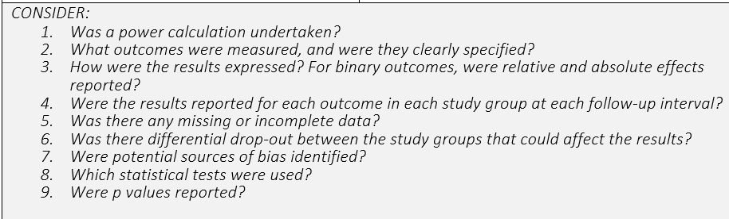
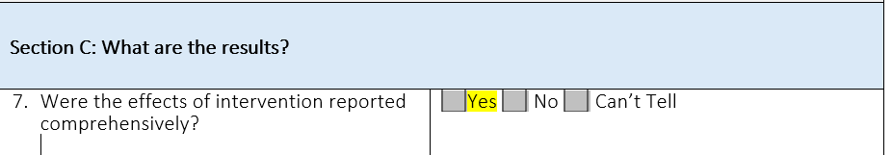
Question 7

Slide 3

Was a power calculation undertaken?

Slide 4
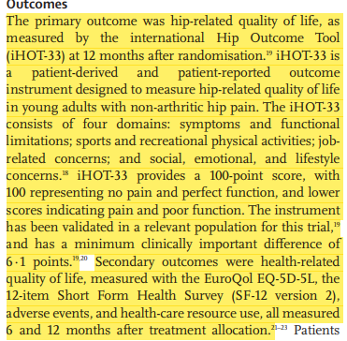
What outcomes were measured, and were they clearly specified?

Slide 5
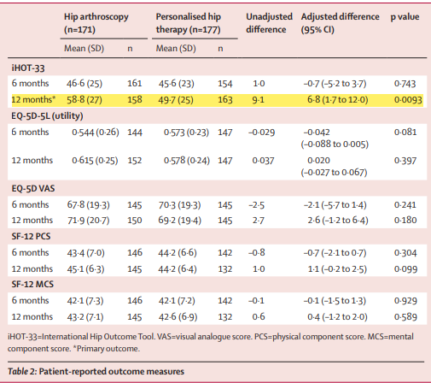
How were the results expressed?
For binary outcomes, were relative and absolute effects reported?
Were the results reported for each outcome in each study group at each follow-up interval?

Slide 6
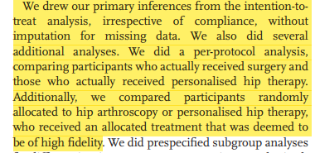
Was there any missing or incomplete data?

Slide 7
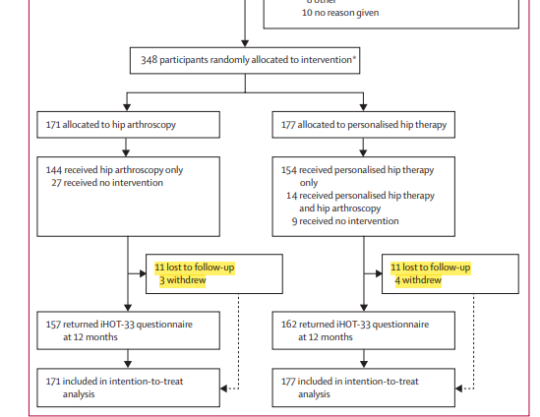
Was there differential drop-out between the study groups that could affect the results?
If there was a large drop out in one group – could show that one interventon was not tolerable

Slide 8
Were potential sources of bias identified?
No specific identification of bias

Slide 9
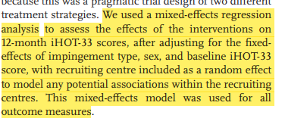
Which statistical tests were used?

Slide 10
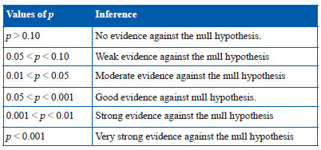
Were P values reported

Slide 11
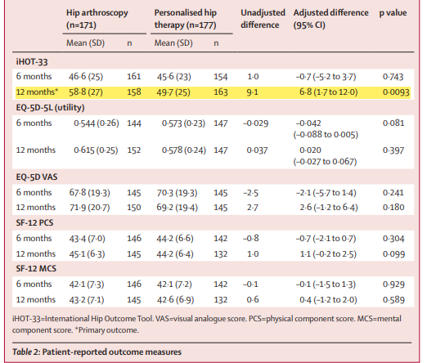
Were P values reported

Slide 12
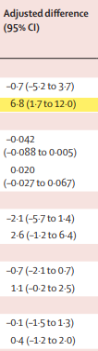

Question 9

Slide 13

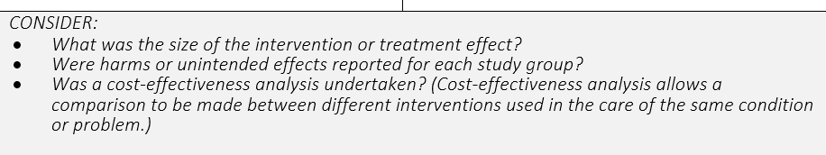
Question 10

Slide 14
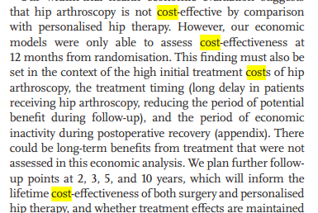
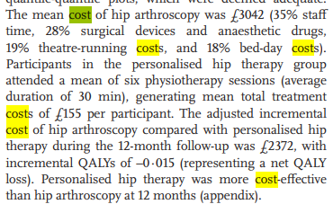
Do the benefits of the experimental intervention outweigh the harms and costs?

Slide 15
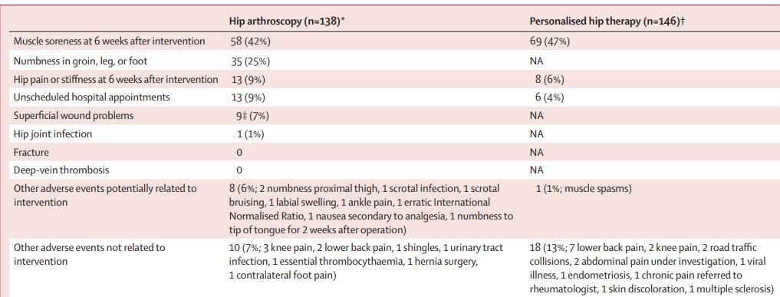
Adverse Events

Slide 16
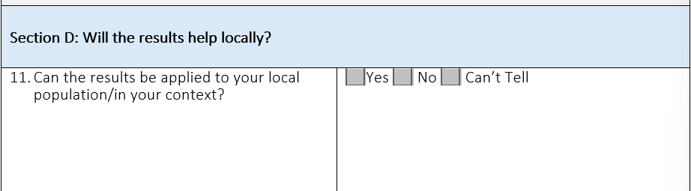
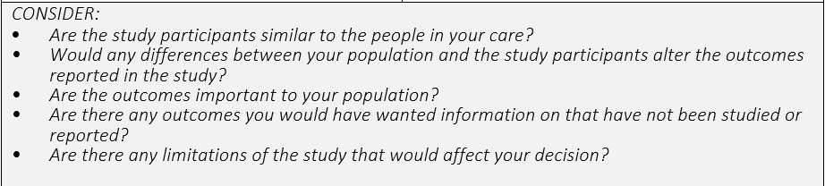
Question 11

Slide 17
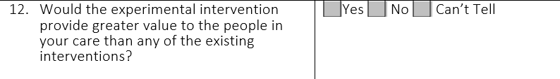
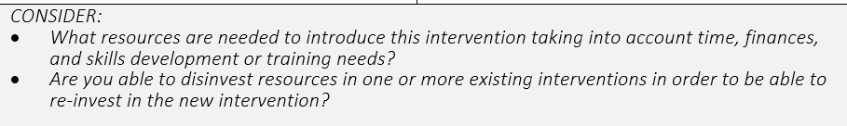
Question 12

Slide 18
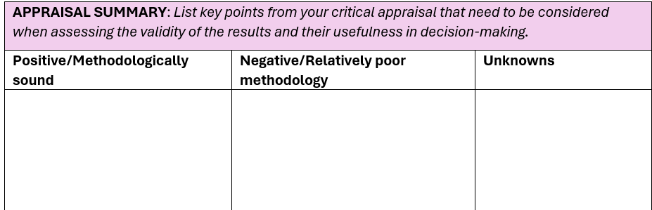
Is the study methodological sound?

Slide 19

Questions

